Slide 1
Introduction to .NET Core Platform and Visual Studio.NET

Slide 2
Objectives
Overview .NET Framework Architecture
Overview .NET Core and .NET
Introduction to Cross-platform application with .NET
Explain why .NET Core and C# Language is selected as develop application?
Explain meaning "dotnet CLI ”
Explain about NuGet package
Demo create and run C# Console Application on Windows, Mac and Linux using “dotnet CLI”

Slide 3
Overview .NET Framework

Slide 4
Introduction to .NET Framework
.NET Framework 1.0
.NET Framework 1.1
.NET Framework 2.0
.NET Framework 3.0
.NET Framework 3.5
.NET Framework 4.0
.NET Framework 4.5
Microsoft .NET Framework 1.0 was released Feb 13, 2002 is the original implementation of .NET
Developed and run-on Windows platform only
Closed
It supports ASP.NET Web Forms, WinForms, WCF, Silverlight, WPF, LINQ, ADO.NET Entity Framework, Parallel LINQ, Task Parallel Library, etc
The .NET Framework 4.8 version was released on April 18, 2019
Notes:
1. .NET Framework to have the possibility of being cross-platform, but Microsoft put their implementation effort into making it work best with Windows

Slide 5
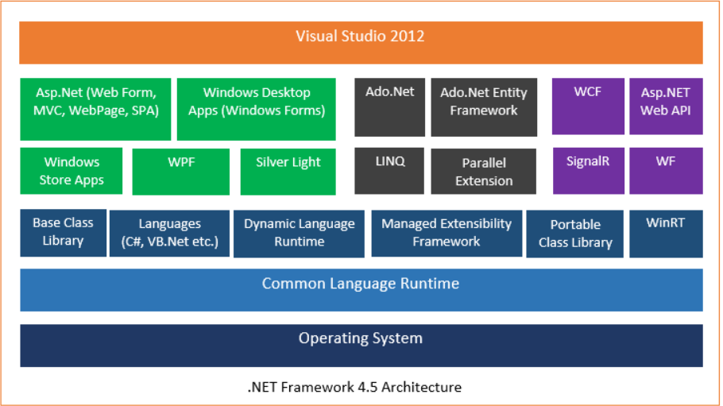
.NET Framework 4.5 Architecture

Slide 6
The .NET Framework Architecture
The two core components of the .NET Framework integral to any application or service development are:
Common Language Runtime (CLR)
Is a backbone of .NET Framework
.NET Framework Class Library (FCL)
Is a comprehensive object-oriented collection of reusable types.
Performs various functions such as:
Error handling, Code safety verification
Garbage collection(GC)
Used to develop applications ranging from traditional command-line to GUI applications that can be used on the Web.
Memory management, Code execution
Notes:
Common Language Runtime (CLR): The execution environment for a managed program. The OS is part of the runtime environment but isn't part of the .NET runtime.
Là một tập hợp hướng đối tượng toàn diện của các kiểu có thể tái sử dụng. Được sử dụng để phát triển các ứng dụng từ dòng lệnh truyền thống đến các ứng dụng GUI có thể được sử dụng trên Web.

Slide 7
Common Language Runtime(CLR)
A common runtime for all .NET languages
Common type system
Common metadata
Intermediate Language (IL) to native code compilers
Memory allocation and garbage collection
Code execution and security
Over 20 languages supported today
C#, VB, Jscript, Visual C++ from Microsoft
Perl, Python, Smalltalk, Cobol, Haskell, Mercury, Eiffel, Oberon, Oz, Pascal, APL, CAML, Scheme, etc.

Slide 8
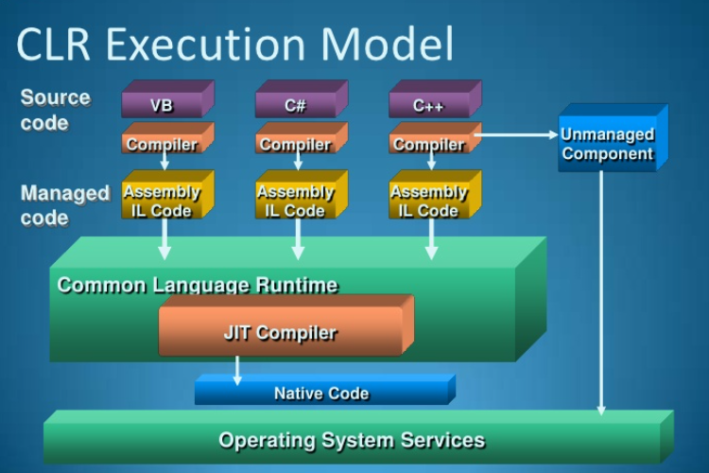
Common Language Runtime(CLR)
Using the .NET Framework:
The code of a program is compiled into CIL (formerly called MSIL) and stored in a file called assembly
This assembly is then compiled by the CLR to the native code at run-time
In traditional Windows applications:
Codes were directly compiled into the executable native code of the operating system

Slide 9
Advantages of CLR
Interoperation between managed code and unmanaged code (COM, DLLs)
Managed code environment
Improved memory handling
JIT(Just-In-Time) Compiler allows code to run in a protected environment as managed code
JIT allows the IL code to be hardware independent
CLR also allows for enforcement of code access security
Verification of type safety
Access to Metadata (enhanced Type Information)

Slide 10
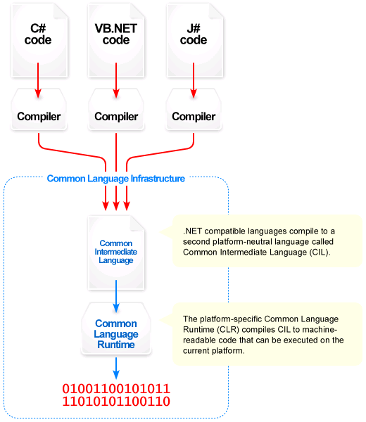
Common Language Infrastructure

Slide 11
Common Language Infrastructure
CLI allows for cross-language development
Four components:
Common Type System (CTS)
Meta-data in a language agnostic fashion
Common Language Specification – behaviors that all languages need to follow
A Virtual Execution System (VES)
Notes:
Hạ tầng
Hệ thống loại chung (CTS)
Siêu dữ liệu theo kiểu ngôn ngữ bất khả tri
Đặc tả ngôn ngữ chung - các hành vi mà tất cả các ngôn ngữ cần tuân theo
Hệ thống thực thi ảo (VES)

Slide 12
Common Type System (CTS)
The common type system defines how types are declared, used, and managed in the common language runtime, and is also an important part of the runtime's support for cross-language integration. The common type system performs the following functions:
Establishes a framework that helps enable cross-language integration, type safety, and high-performance code execution
Provides an object-oriented model that supports the complete implementation of many programming languages
Defines rules that languages must follow, which helps ensure that objects written in different languages can interact with each other
Provides a library that contains the primitive data types (such as Boolean, Byte, Char, Int32, and UInt64) used in application development

Slide 13
Common Type System (CTS)
The common type system in .NET supports the following five categories of types:
Classes
Structures
Enumerations
Interfaces
Delegates
Notes:
Các lớp
Cấu trúc
Liệt kê
Giao diện
Ủy nhiệm

Slide 14
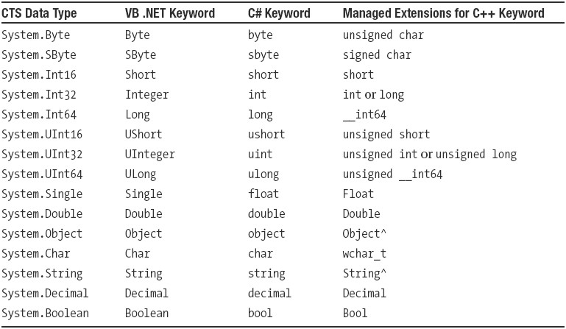
CTS Data Types

Slide 15
The .NET Framework Architecture
Common Language Specification (CLS)
The CLS comprises a set of rules that any language that targets the CLI needs to adhere to, to be able to interoperate with other CLS-compliant languages
CLS rules fall into the broader rules of the CTS and therefore it can be said that the CLS is a subset of CTS
Language constructs that make it impossible to easily verify the type safety of the code were excluded from the CLS so that all languages that work with the CLS can produce verifiable code
Notes:
The CTS supports two categories of types:
• Value types: These contain their data directly and have copy semantics, which means when an object of such a type is copied its data is copied.
• Reference types: These contain references to the memory address where the data is stored. When an object of a reference type is copied, the reference is copied and not the data it points to.

Slide 16
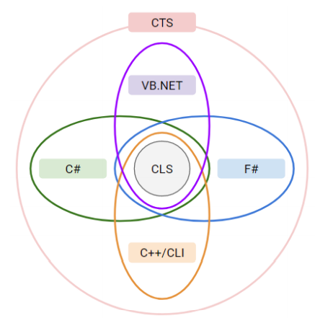
The .NET Framework Architecture
The relationship between the CTS and CLS
Notes:
Common Language specification (CLS)
Common Type System (CTS)

Slide 17
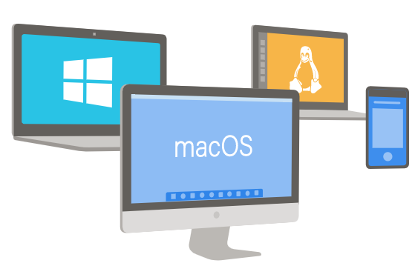
Cross-Platform Application
“Write once, run anywhere” seems to be the mantra that finds favor with application developers nowadays. This reduces the need for developers to write a lot of redundant code. .NET, an open source offering from Microsoft, is just the tool for writing code for a cross-platform application that will work on Windows, Linux and macOS systems

Slide 18
Cross-Platform Application
A platform is a computer hardware and software combination on which a program runs. A platform is a combination of both hardware resources: CPU frequency, RAM size, HDD space, GPU capacity,…and also the software platform being provided to install on such as Operating system; Third-party or extended framework(.NET or JVM,..)
Cross-platform support runs on multiple platforms. In a sense, it means that a code can run on multiple frameworks, platforms, operating systems, and machine architectures
A cross-platform programming language is one that can run on multiple frameworks, operating systems, and machine architectures. Many factors cause the language or tool to be able to run on multiple machines and platforms

Slide 19
Overview .NET Core

Slide 20
What is the .NET Core?
It is a cross-platform, open-source framework that implements .NET Standard
It includes JIT(Just-In-Time) Compiler, GC(Garbage Collection) and several low-level classes
It provides a runtime known as .NET Core CLR, framework class libraries, which are primitive libraries known as CoreFX, and APIs that are similar to CLR and BCL(Base Class Library) of .NET Framework, but have a smaller footprint (lesser dependencies on other assemblies)
Notes:
.NET Framework 1.0 was released Feb 13, 2002
.NET Core 1.0 was released on June 27, 2016

Slide 21
What is the .NET Core?
CoreFX is made of foundation class libraries. These come as alternatives to CLR and BCL of .NET Framework. It comes integrated with .NET Core CLI
It supports modern application frameworks such as gRPC, ML.NET for Machine Learning, ASP.NET Core Razor Pages, Blazor (for WebAssembly), UWP(Universal Windows Platform), etc
The .NET Core 5(.NET) version was released November 10, 2020

Slide 22
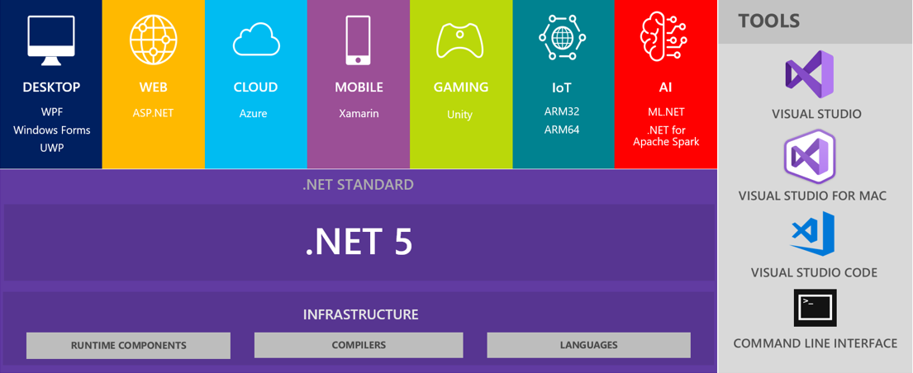
.NET 5 (.NET) = .NET Core vNext
Released on November 10, 2020 (Visual Studio 2019 and C# 9.0)
Notes:
+.NET Framework 1.0 was released Feb 13, 2002
+.NET Core 1.0 was released on June 27, 2016
+.NET Core 2.0 was released on August 14, 2017
+.NET Core 3.0 was released on September 23, 2019
+.NET Core 5.0 was released on Jan 12, 2021

Slide 23
What is the .NET Standard?
.NET Standard is a specification that can be used across all .NET implementations. It is used for developing library projects only. This means if we are creating a library in .NET Standard we can use those in .NET Framework and .NET Core
To create uniformity means to allow usage in all the .NET implementations. .NET Standard has support for Mono platform, Xamarin, Universal Windows Platform, and Unity

Slide 24
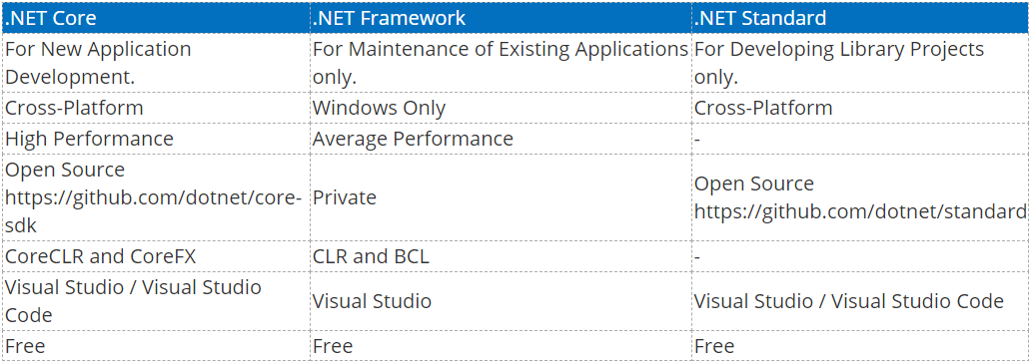
Comparisons Table

Slide 25
New features in .NET 5 (.NET)
Java interoperability will be available on all platforms
Objective-C and Swift interoperability will be supported on multiple operating systems
CoreFX will be extended to support static compilation of .NET (ahead-of-time – AOT), smaller footprints and support for more operating systems
Notes:
Microsoft has scheduled the new .NET 5.0 (GA) for November 2020, .NET 6.0 (LTS) for November 2021, .NET 7.0 (GA) for November 2022, and .NET 8.0 (LTS) for November 2023.
Khả năng tương tác Java sẽ có sẵn trên tất cả các nền tảngKhả năng tương tác
Objective-C và Swift sẽ được hỗ trợ trên nhiều hệ điều hành
CoreFX sẽ được mở rộng để hỗ trợ biên dịch tĩnh .NET (trước thời hạn - AOT), dấu chân nhỏ hơn và hỗ trợ nhiều hệ điều hành hơn

Slide 26
Benefits of using .NET
Open Source: Open source and community-oriented on GitHub.
Cross-Platform: .NET Core can run on Windows, Linux, and macOS
Command-line tools: Create, build, and run projects from the command line
Modular: Ships as NuGet packages
Host Agnostic:
.NET Core on the server side is not dependent on IIS and, with two lightweight servers: Kestrel and WebListener
It can be self-hosted as a Console application and can be also gelled with mature servers such as IIS, Apache, and others through a reverse proxy option
Notes:
.NET Framework 1.0 was released Feb 13, 2002
.NET Core 1.0 was released on June 27, 2016

Slide 27
Benefits of using .NET
Support for leveraging platform-specific capabilities, such as Windows Forms and WPF(Windows Presentation Foundation) on Windows and the native bindings to each native platform from Xamarin
High performance
Side-by-side installation
Small project files (SDK-style)
Visual Studio, Visual Studio for Mac, and Visual Studio Code integration
Notes:
.NET Framework 1.0 was released Feb 13, 2002
.NET Core 1.0 was released on June 27, 2016
What is the Xamarin Platform? – .NET cross-platform mobile
With the Xamarin Platform you can deliver native Android, iOS, MacOS and Windows apps, using existing .NET skills, teams, and code.
The Xamarin Platform is based on Mono. Mono is the original open source and cross-platform implementation of .NET, from the community Mono Project.
It is now sponsored by Xamarin/Microsoft. Traditionally, Mono’s APIs have followed the progress of the .NET Framework, not .NET Core.

Slide 28
.NET components
Language compilers: These turn source code written with languages such as C#, F#, and Visual Basic into intermediate language (IL) code stored in assemblies. NET language compilers for C# and Visual Basic, also known as Roslyn
Common Language Runtime (CoreCLR): This runtime loads assemblies, compiles the IL code stored in them into native code instructions for computer's CPU, and executes the code within an environment that manages resources such as threads and memory
Base Class Libraries (BCLs) of assemblies in NuGet packages (CoreFX): These are prebuilt assemblies of types packaged and distributed using NuGet for performing common tasks when building applications

Slide 29
Why C# is selected as develop application?
C# was developed by Anders Hejlsberg and his team during the development of .NET
C# is a modern, object-oriented, and type-safe programming language. C# enables developers to build many types of secure and robust applications that run in the .NET ecosystem. C# has its roots in the C family of languages and will be immediately familiar to C, C++, Java, and JavaScript programmers
C# is designed for Common Language Infrastructure (CLI), which consists of the executable code and runtime environment that allows use of various high-level languages on different computer platforms and architectures

Slide 30
Why C# is selected as develop application?
The following reasons make C# a widely used professional language
It is a modern, general-purpose programming language
It is object oriented.
It is component oriented.
It is easy to learn.
It is a structured language.
It produces efficient programs.
It can be compiled on a variety of computer platforms.
It is a part of .Net
More C# features :
https://docs.microsoft.com/en-us/dotnet/csharp/language-reference/

Slide 31
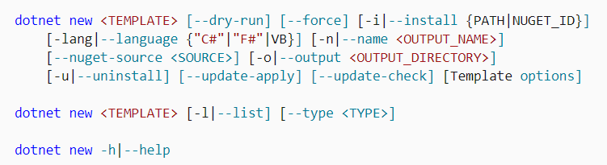
Introduction to dotnet CLI
The .NET command-line interface(CLI) is a cross-platform for developing, building, running, and publishing .NET applications
More dotnet CLI:
https://docs.microsoft.com/en-us/dotnet/core/tools/dotnet/

Slide 32
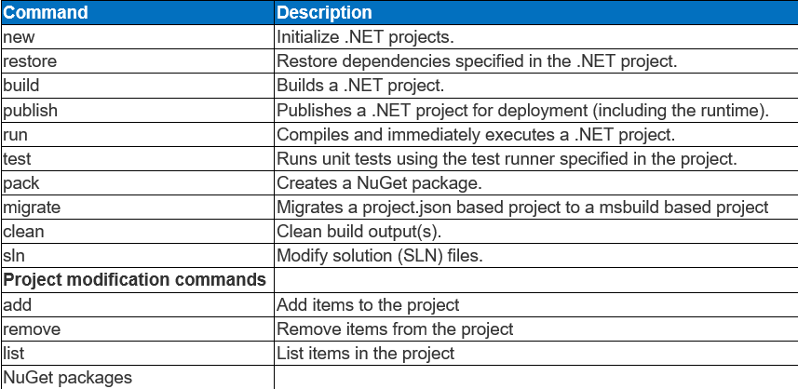
Introduction to dotnet CLI

Slide 33
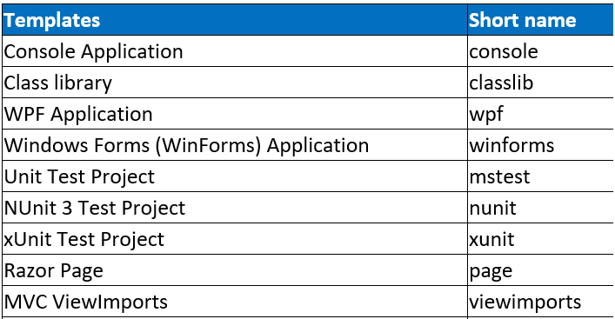
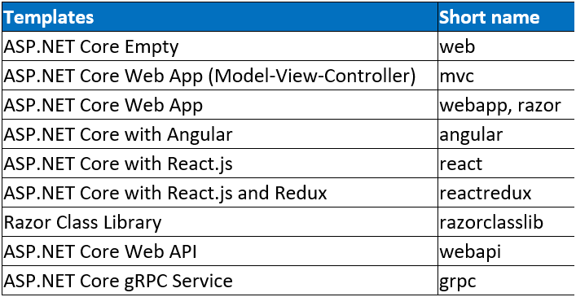
Introduction to dotnet CLI

Slide 34
Demo Create a C# Console App using dotnet CLI

Slide 35
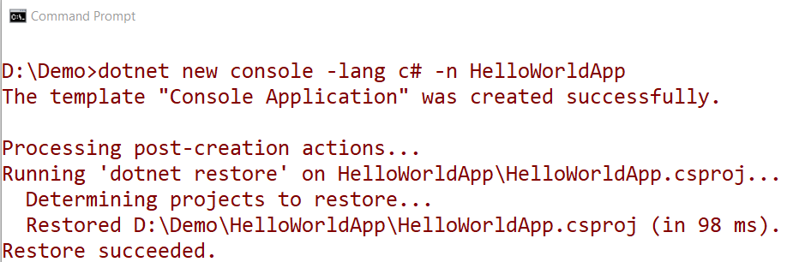
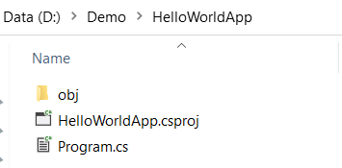
On Windows OS
Install package: dotnet-sdk-5.0.102-win-x64.exe and open Command Prompt dialog
1. Create Console App named HelloWorldApp with C# language

Slide 36
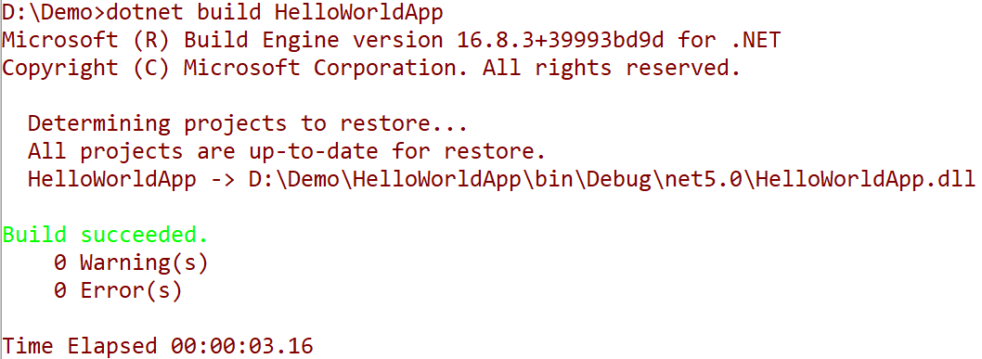
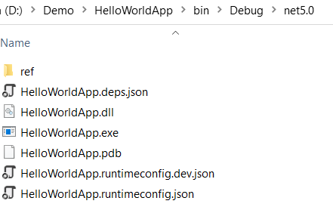
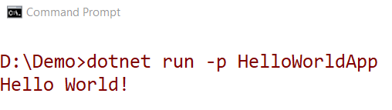
2. Build HelloWorldApp application
3. Run HelloWorldApp application

Slide 37
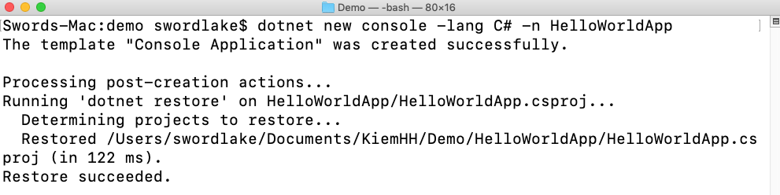
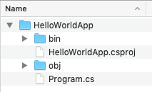

On macOS 10.14 "Mojave"
Install package: dotnet-sdk-5.0.102-osx-x64.pkg and open Terminal dialog
1. Create Console App named HelloWorldApp with C# language
2. Run HelloWorldApp application

Slide 38
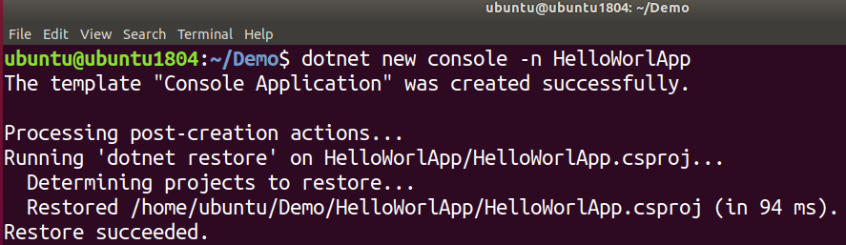
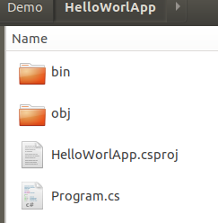

On Linux(Ubuntu 14.05) OS
Install package: dotnet-sdk-5.0 and open Terminal dialog
1. Create Console App named HelloWorldApp with C# language
2. Run HelloWorldApp application

Slide 39
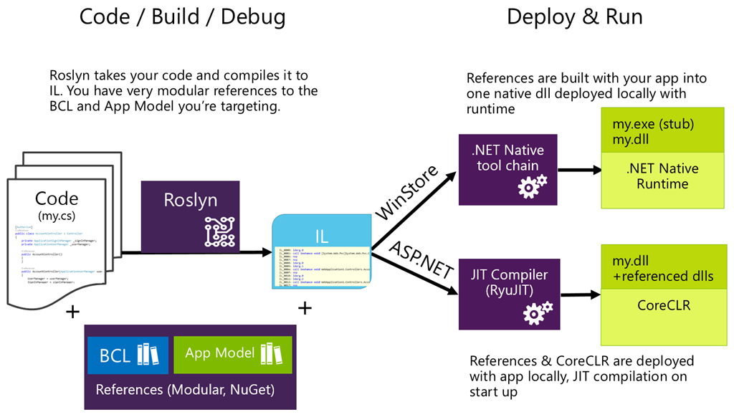
Compilation Process .NET Application

Slide 40
Compilation Process .NET Application
The compiler used by the dotnet CLI tool converts .NET source code(C#/VB/C++,..) into Intermediate Language (IL) code, and stores the IL in an assembly (a DLL or EXE file)
IL code statements are like assembly language instructions, but they are executed by .NET Core's virtual machine, known as the CoreCLR
At runtime, the CoreCLR loads the IL code from the assembly, JIT compiles it into native CPU instructions, and then it is executed by the CPU on your machine
The benefit of this two-step compilation process is that Microsoft can create CLRs for Linux and macOS as well as for Windows. The same IL code runs everywhere because of the second compilation process that generates code for the native operating system and CPU, etc

Slide 41
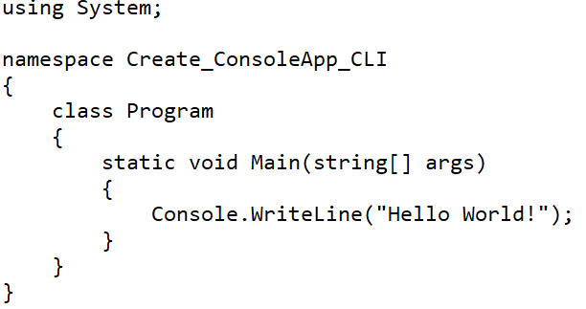
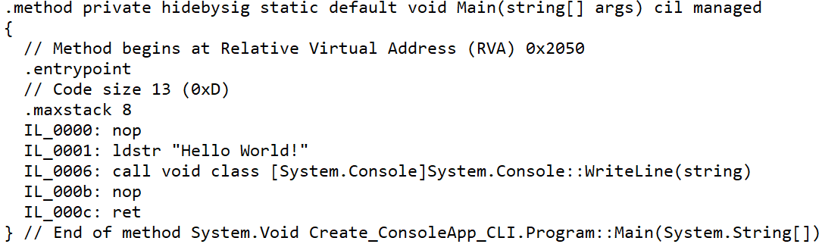
Common Intermediate Language (CIL)
CIL is a platform-neutral intermediate language (formerly called Microsoft Intermediate Language or MSIL) that represents the intermediate language binary instruction set defined by the CLI. It is a stack-based object-oriented assembly language that represents the code in byte-code format
C# source code
MSIL code
Notes:
To view MSIL of the assemblies :
1.Install ildasm tool : dotnet tool install -g dotnet-ildasm
2.View IL : dotnet ildasm Create_ConsoleApp_CLI.dll -o OutpuFileILCode.il

Slide 42

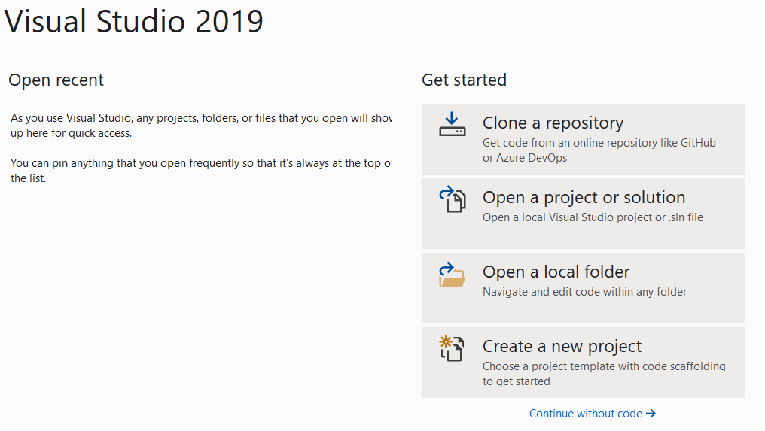
Introduction to Visual Studio.NET
Read by yourself
Visual Studio is one of the most famous IDE’s has been using for the last few years. Microsoft developed it. It is used to create a computer program, web applications, and EXE files, etc. The first version of its kind was launched in 1997. And now the latest version available in the market is Visual Studio 2019

Slide 43
Introduction to Visual Studio.NET
Read by yourself
New User Experienced Start Window: Check out the code, Open a project, Open a folder and Create a new project
Visual Studio Live Share: Live Share is a developer service in Visual Studio 2019. This feature directly enables to share code context and debugging process with your teammates and get live access within Visual Studio itself like Google document services
Improved Refactoring: Refactoring in any IDE will highly helpful for developers. In Visual Studio 2019 these refactorings will come up with new advanced features, and these are used to organize your code in a structured manner

Slide 44
Introduction to Visual Studio.NET
Enhanced Search Experience
Search Feature While in Debugging
Visual Studio IntelliCode
Code cleanup in One Click
Integrated Code Reviews in Development
Per Monitor Aware Rendering(PMA)
New Delivery Model for SQL Server Data Tools

Slide 45
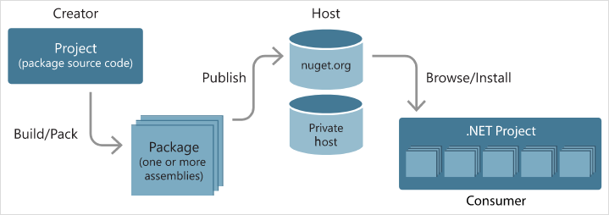
Introduction to Nuget packages
.NET is split into a set of packages, distributed using a Microsoft supported package management technology named NuGet. Each of these packages represents a single assembly of the same name
For example, the System.Collections package contains the System.Collections.dll assembly

Slide 46
Introduction to Nuget packages
Read by yourself
Install and use a package for .NET project in Visual Studio
Using NuGet Package Manager
(For Windows: https://docs.microsoft.com/en-us/nuget/quickstart/install-and-use-a-package-in-visual-studio )
(For Mac: https://docs.microsoft.com/en-us/nuget/quickstart/install-and-use-a-package-in-visual-studio-mac )
Using the dotnet CLI
(https://docs.microsoft.com/en-us/nuget/quickstart/install-and-use-a-package-using-the-dotnet-cli )

Slide 47
Summary
Concepts were introduced:
Overview about .NET Core, .NET 5(.NET) and .NET Framework
Overview .NET Framework and .NET 5(.NET) Architecture
Overview new features of Visual Studio.NET
Explain about Cross-platform application with .NET
Why .NET Core and C# Language is selected as develop application?
Explain and demo using “dotnet CLI” to create C# Console App
Overview NuGet package
Create and Run cross-platform Console application with C#

